Slide 1

Cloud Solution Architect
Module 2
Lecture 4
Package Manager and Software Installation in Ubuntu

Slide 2
Recap
Module 2 - Lecture 3
Introduction to Command Line Interface (CLI)
Linux Directory Structure
Linux Basic Commands

Slide 3
Learning Objectives
Module 2 - Lecture 4
Package Manager
Public Repositories
Software installation using package manager

Slide 4
Package Manager
A collection of software tools that automates the process of installing, upgrading, configuring, and removing computer programs for a computer in a consistent manner.
A package manager deals with packages, distributions of software and data in archive files

Slide 5
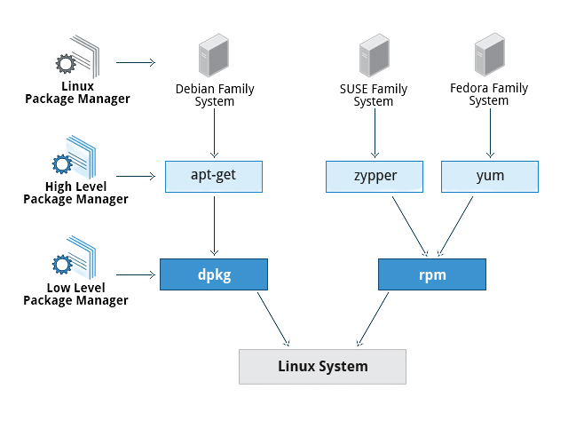
Package Manager

Slide 6



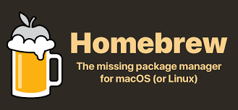
Package Managers
apt: Advanced Package Tool (Ubuntu, Debian)
yum: Yellowdog Updater, Modified (CentOS)
rpm: Red Hat Package Manager (RehHat)
homebrew: package manager for MacOS

Slide 7
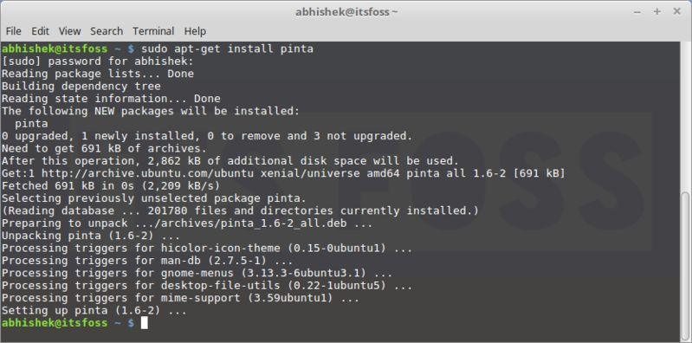
Package Manager
apt: Advanced package tool.

Slide 8
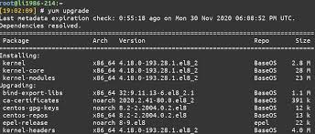
Package Manager
Yum: primary tool for getting, installing, deleting, querying, and otherwise managing Red Hat Enterprise Linux RPM software packages from official Red Hat software repositories.

Slide 9
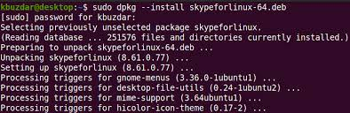
Package Manager
dpkg: Install, remove and manage Debian packages.

Slide 10
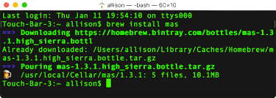
Package Manager
brew: free macOS package manager that allows you to install, update, or remove software by running commands in the terminal.

Slide 11
Advanced Package Tool
apt-get vs apt
apt-get
apt-get is lower-level and "back-end", and supports other APT-based tools.
apt
apt is designed for end-users (humans) and its output may be changed between versions

Slide 12
Repository
collection of deb packages with metadata that is readable by the apt family
In Debian or Ubuntu, the software repositories are defined in /etc/apt/sources.list
Third-party repositories can be added in Ubuntu, add its link to the file mentioned above
Personal Package Archives (PPAs) are software repositories designed for Ubuntu users and are easier to install than other third-party repositories
PPAs are often used to distribute pre-release software so that it can be tested.

Slide 13
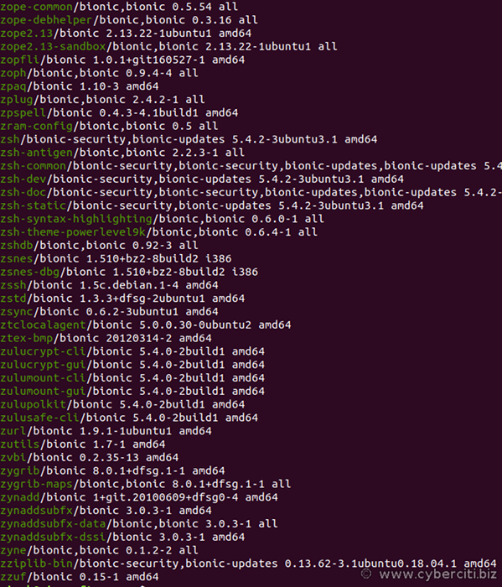
Software Listing
apt list

Slide 14
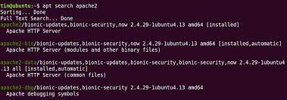
Software Search
apt search [package name. apache2}

Slide 15
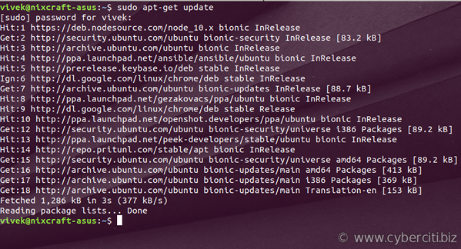
Software Update
apt update.

Slide 16
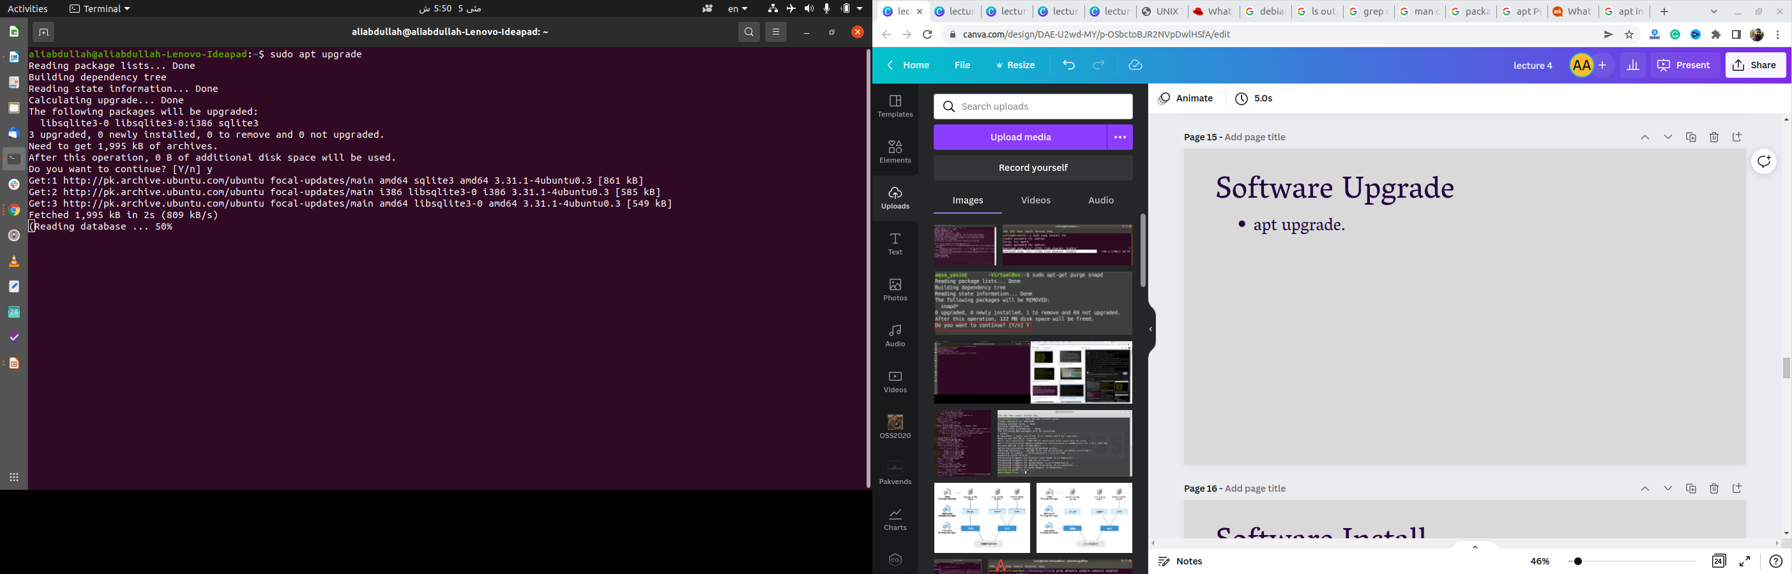
Software Upgrade
apt upgrade.

Slide 17
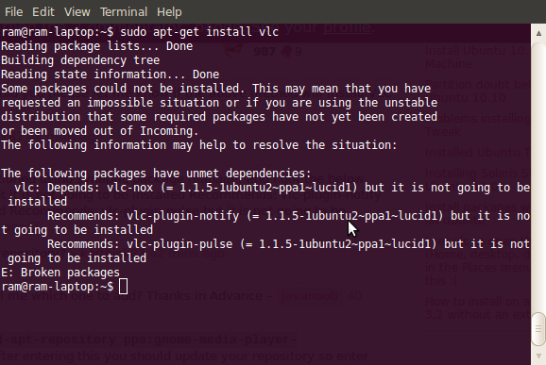
Software Install
apt install {package name. vlc}

Slide 18
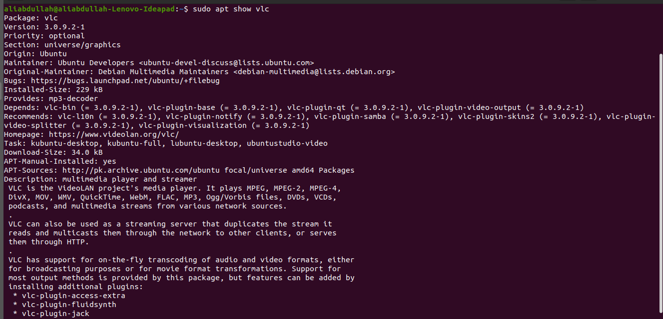
Software Details
apt show {package name. vlc}

Slide 19
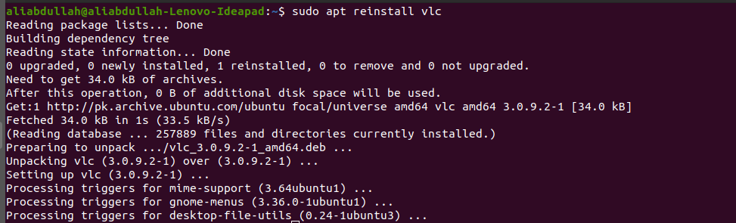
Software Reinstallation
apt reinstall [package-name. skype]

Slide 20
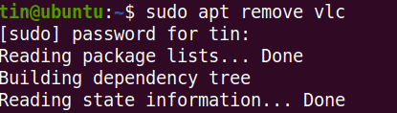
Software Deletion
apt remove [package-name.vlc]

Slide 21
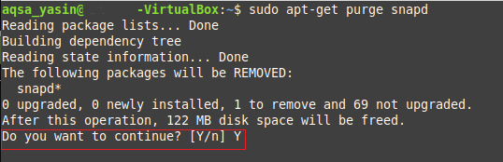
Software Deletion
(With all dependencies removed)
apt purge [package-name.vlc]

Slide 22
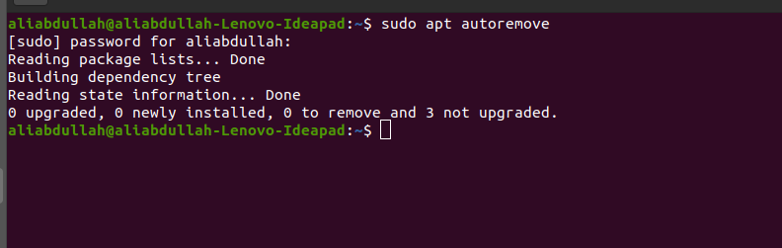
All Unnecessary Softwares Deletion
apt autoremove.

Slide 23
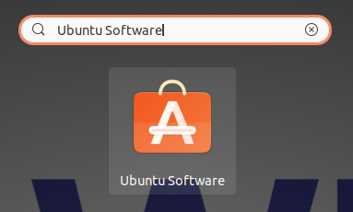
GUI Installation
Ubuntu Software

Slide 24
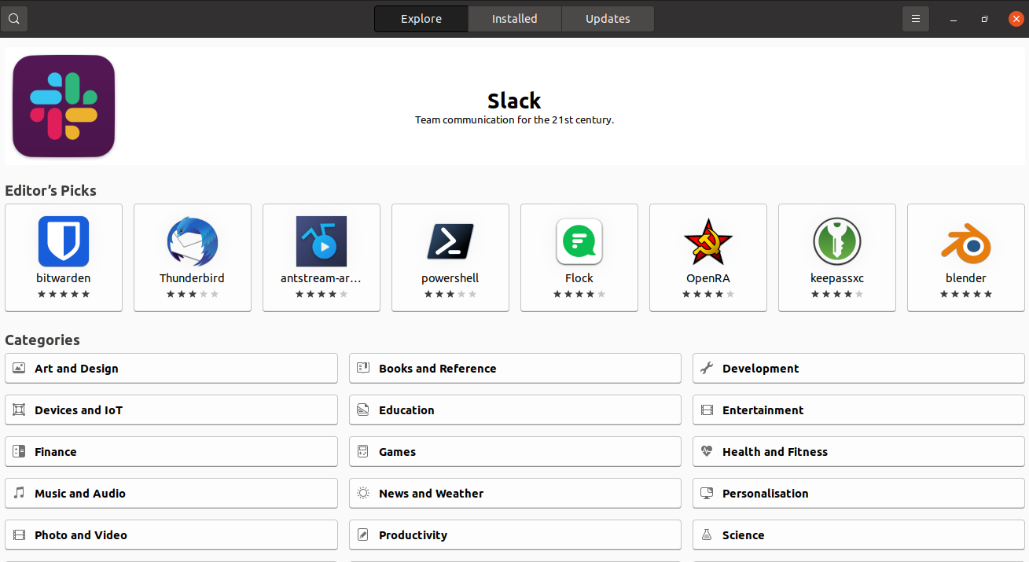
GUI Installation
Ubuntu Software Interface

Slide 25
GUI Installation
Search a software

Slide 26
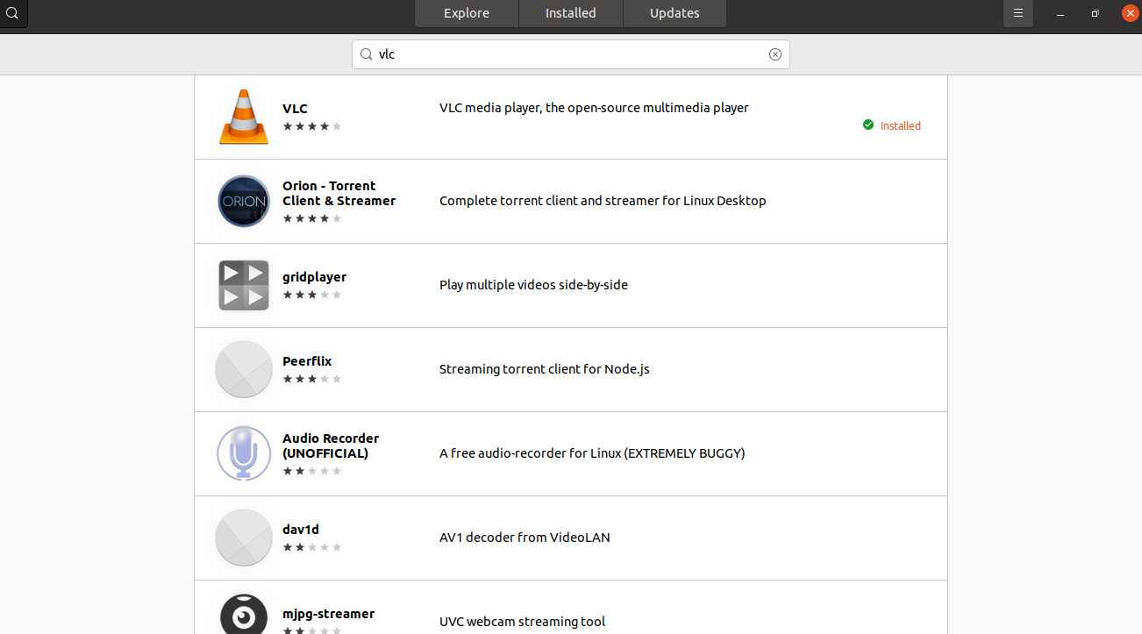
GUI Installation
Search a software

Slide 27
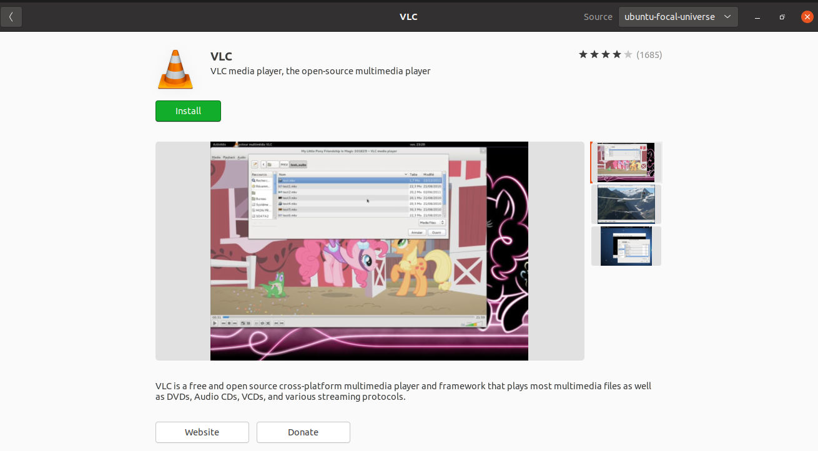
GUI Installation
Click on the software to see its details

Slide 28
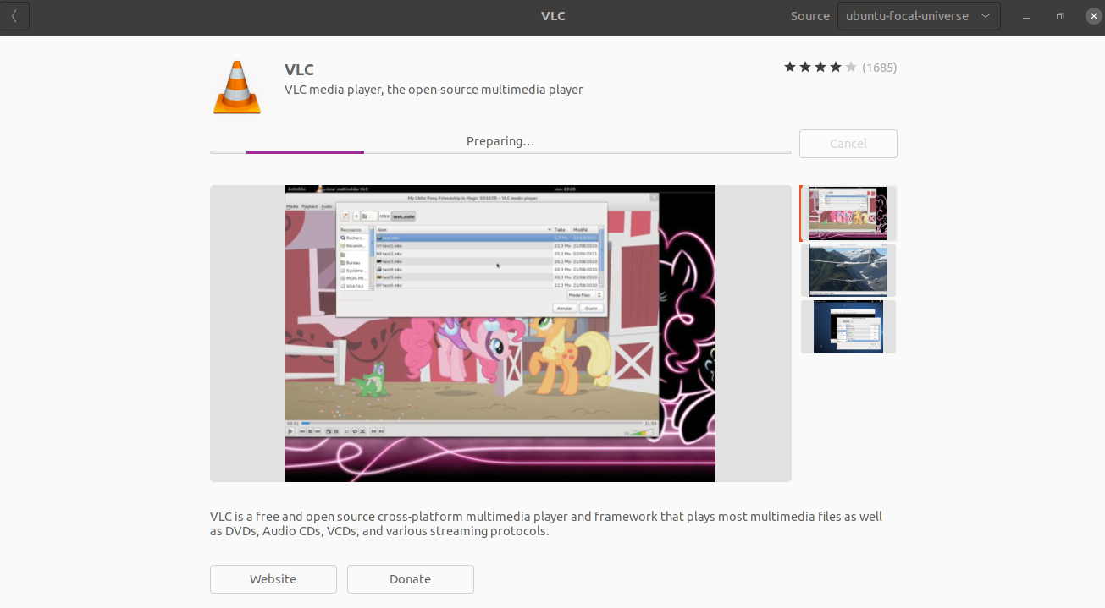
GUI Installation
Click install button to install the package

Slide 29
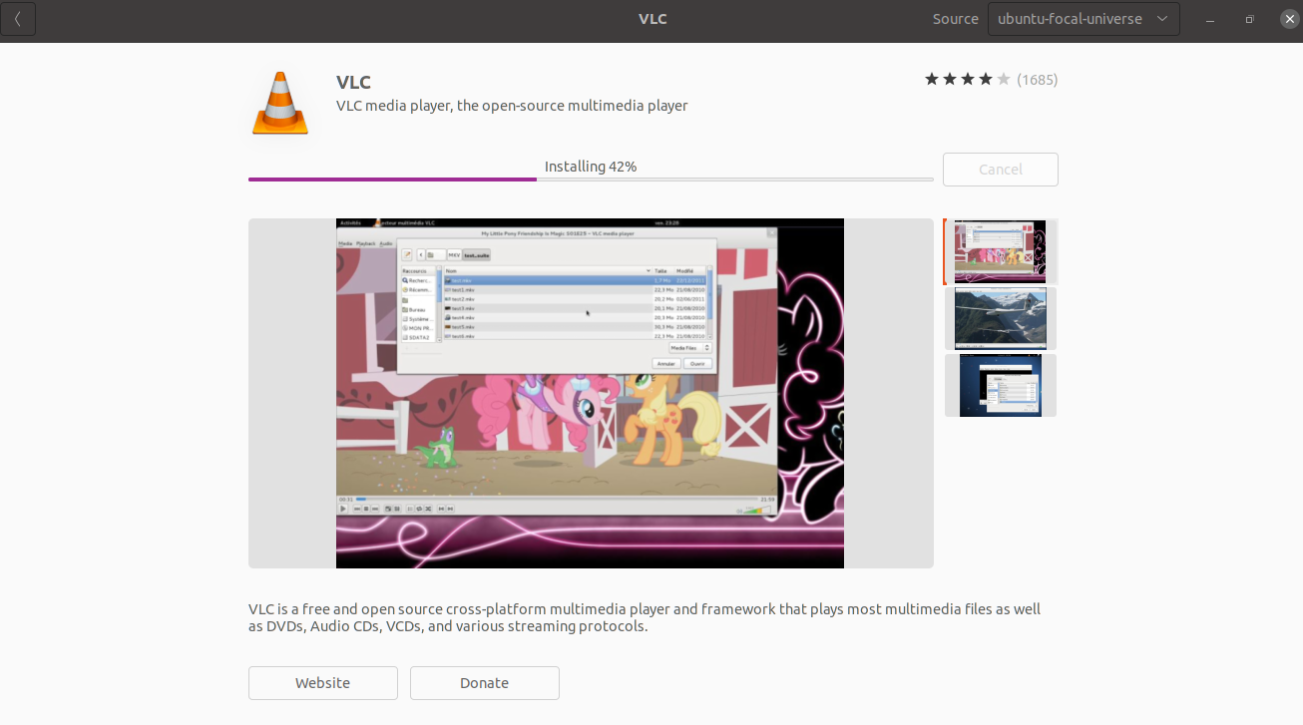
GUI Installation
package installing

Slide 30
GUI Installation
status after installation of the pakcage

Slide 31
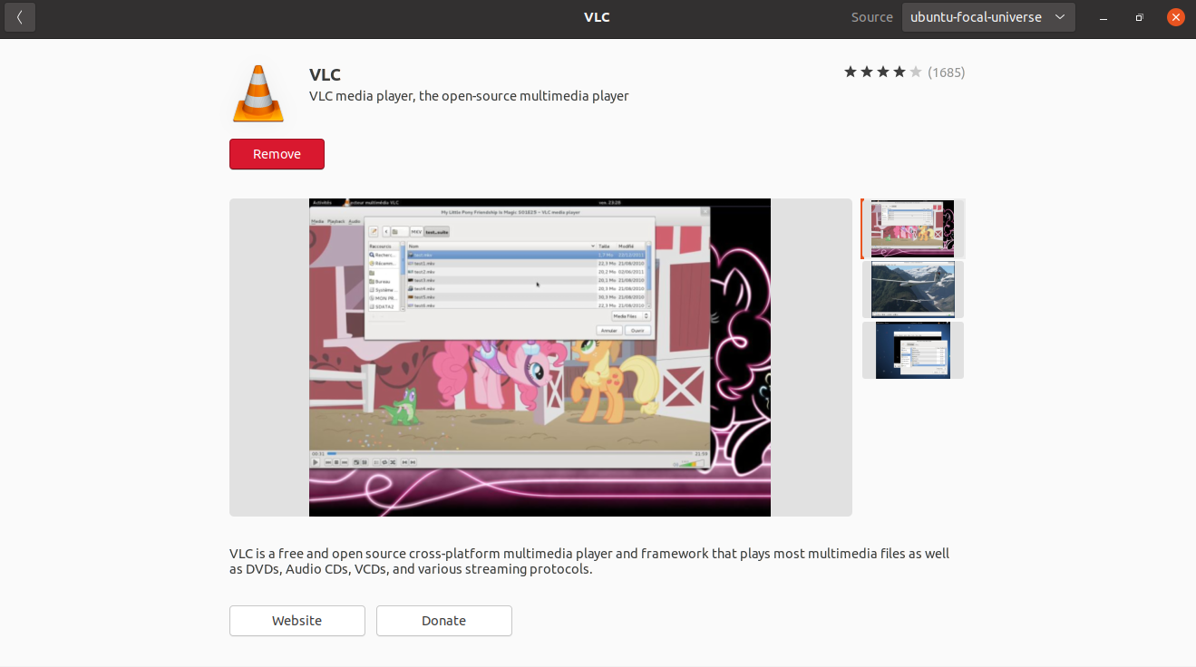
GUI Installation
Click remove button to delete the package

Slide 32
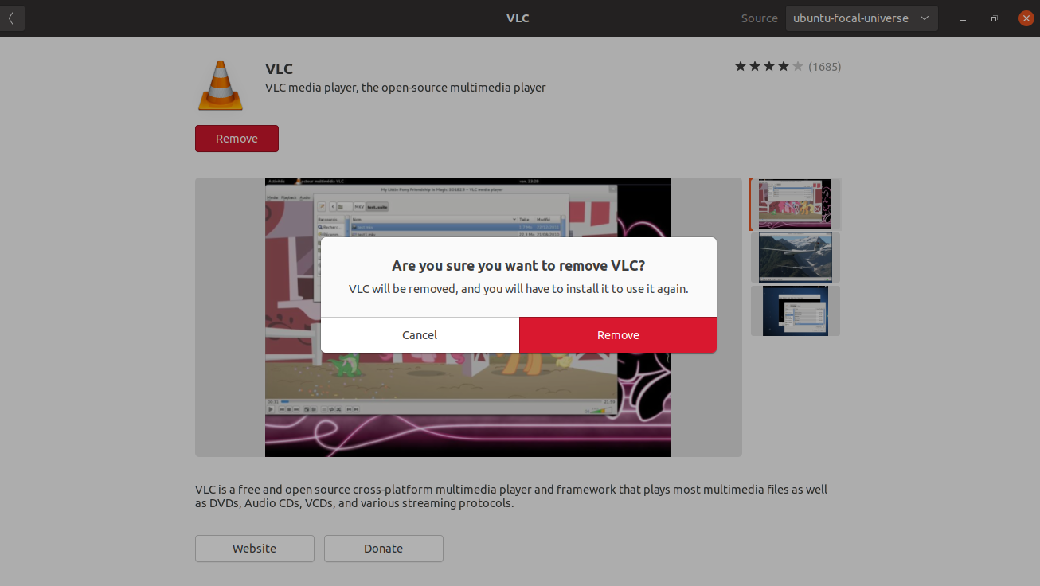
GUI Installation
Click remove button to delete the package

Slide 33
Learning Objectives
Module 2 - Lecture 4
Package Manager
Public Repositories
Software installation using package manager

Slide 34
Next Lecture
Module 2 - Lecture 5
Bourne-Again Shell (bash)
Linux Kernel
User Management
System Administration

Slide 35

Ask Questions!!

